Slide 1
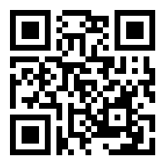
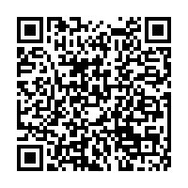


HeteroFL:
Computation and Communication Efficient Federated Learning for Heterogeneous Clients
Presenter: Enmao Diao, Duke University
Paper
Code
Enmao Diao¹ Jie Ding² Vahid Tarokh¹
¹Duke University ²University of Minnesota
Notes:
Hello everyone my name is Enmao Diao today I will present HeteroFL:
Computation and Communication Efficient Federated Learning for Heterogeneous Clients.
This work is published by Enmao Diao, Jie Ding, and Vahid Tarokh .
You can access our paper and source codes by scanning these QR codes.

Slide 2
Overview
Motivation
Heterogeneous Federated Learning
  Heterogenous models
  Static Batch Normalization (sBN), Scaler, and Masked Cross-Entropy Loss
Experiments
  Interpolation experimental results
  Combination of various computation complexity
Conclusion
Notes:
First, I will talk about our motivation.
Then I will discuss Heterogeneous Federated Learning including Heterogenous models and other proposed techniques such as Static Batch Normalization (sBN), Scaler, and Masked Cross-Entropy Loss.
Finally, we will demonstrate our experimental results and draw our conclusion.

Slide 3
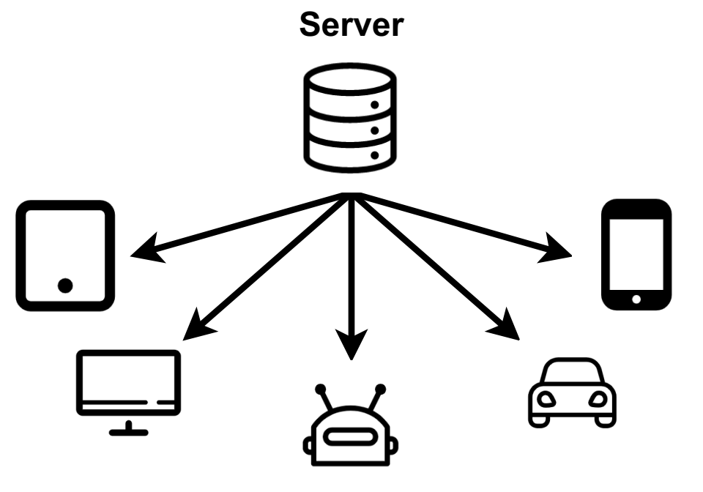
Motivation
Emerging: a large set of heterogeneous IoT devices
Existing federated learning: one global model architecture for all client devices
Figure 1. The computation and communication capabilities of each local client may vary significantly and even dynamically.
Notes:
In the era of emerging Internet of Things, the number of IoT devices increases dramatically.
Existing federated learning assumes one global model architecture for all client devices.
However, The computation and communication capabilities of each local client may vary significantly and even dynamically

Slide 4
Motivation
Local models must share the same architecture as the global model in federated learning?
Figure 1. The computation and communication capabilities of each local client may vary significantly and even dynamically.
Notes:
We challenge the notion that local models must share the same architecture as the global model in federated learning.

Slide 5
Motivation
HeteroFL: to enable the training of heterogeneous local models with dynamically-varying computation complexities, while still producing a single global inference model!
Figure 1. The computation and communication capabilities of each local client may vary significantly and even dynamically.
Notes:
We propose HeteroFL to train heterogeneous local models with dynamically-varying computation complexities, while still producing a single global inference model.

Slide 6
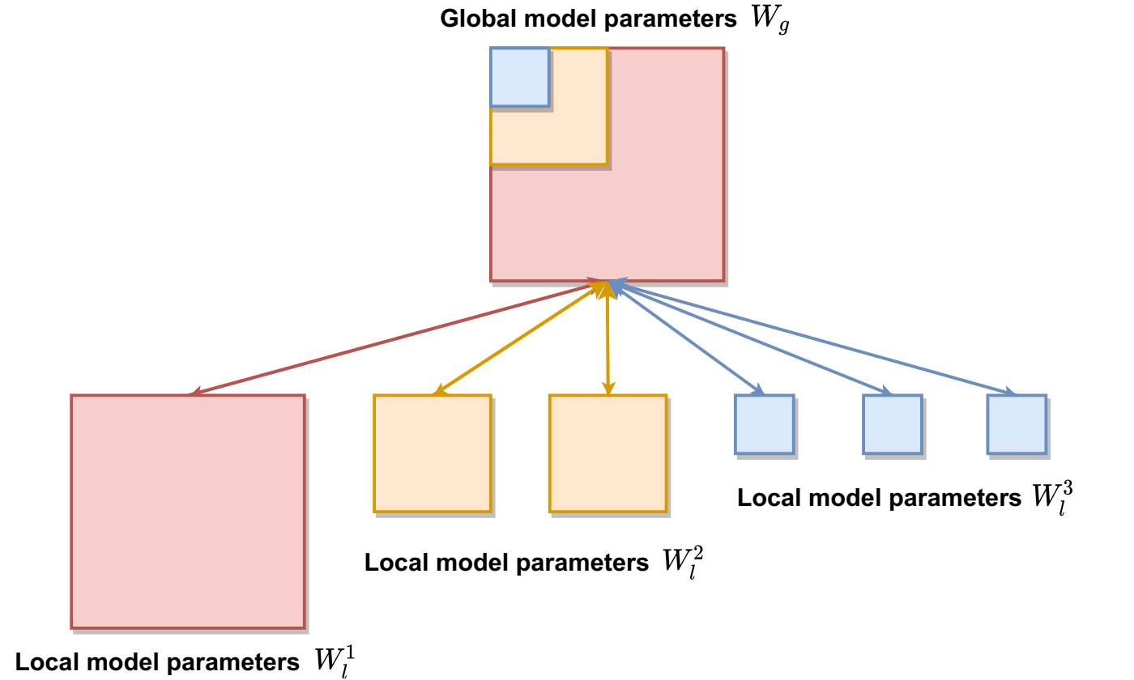
Heterogeneous Federated Learning (HeteroFL)
Small local models can benefit more from FL by performing global aggregation on a part of larger local model parameters.
Figure 2. Global model parameters are distributed to 6 local clients with 3 computation complexity levels.
Notes:
Our method shows that small local models can benefit more from FL by performing global aggregation on a part of larger local model parameters.
We choose to vary the width of hidden layers. In this way, we can significantly reduce the number of local model parameters, while the local and global model architectures are also within the same model class, which stabilizes global model aggregation.
We empirically found that this approach produces better results than uniformly sampled subnetworks for each client or computation complexity level.

Slide 7
Heterogeneous Federated Learning (HeteroFL)
Static Batch Normalization (sBN) does not track running estimates and cumulatively update global BN statistics after training is finished.
Scaler scales representations during the training phase and the global model can be directly used for inference without scaling.
Masked Cross-Entropy Loss replaces the last layer outputs that are not associated with local labels.
Notes:
We also propose some useful techniques .
Static Batch Normalization does not track running estimates and cumulatively update global BN statistics after training is finished.
Scaler scales representations during the training phase and the global model can be directly used for inference without scaling.
Masked Cross-Entropy Loss replaces the last layer outputs that are not associated with local labels.

Slide 8
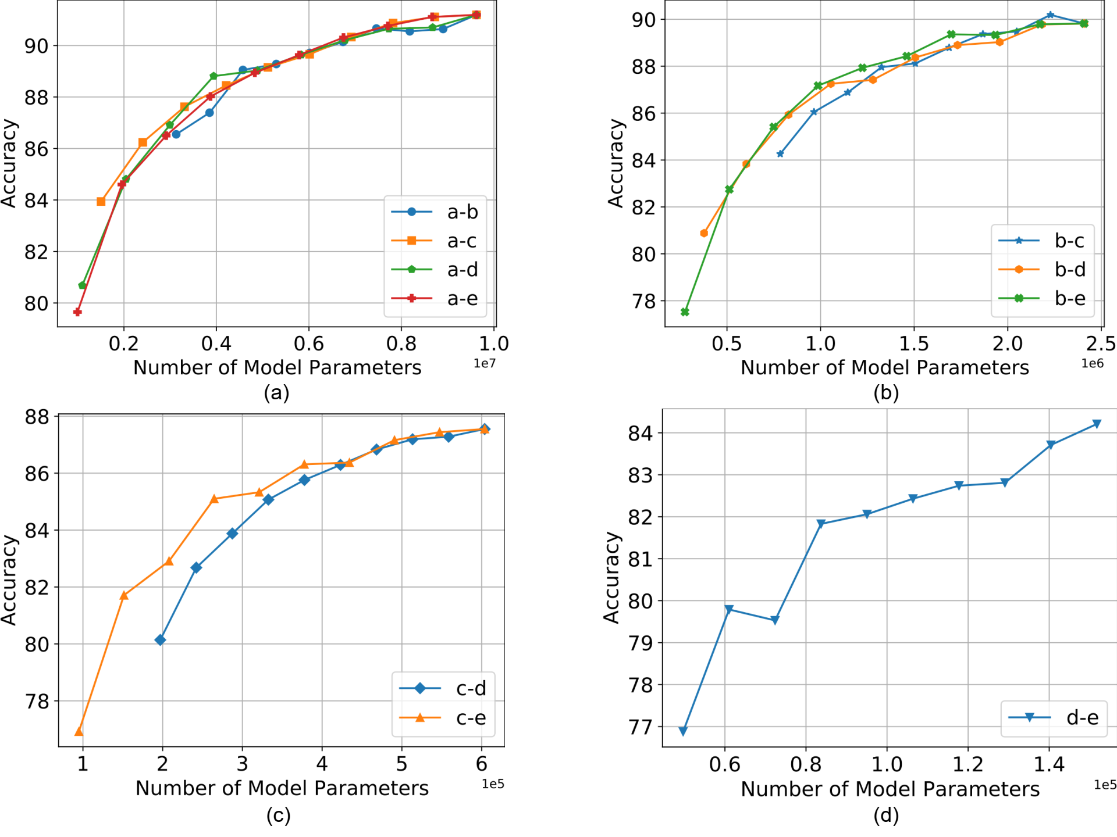
Experiments
Figure 3. Interpolation experimental results for CIFAR10 (IID) dataset between global model complexity and various smaller model complexities (denoted by a, b, c, d).
Notes:
We interpolate the proportion of small local models and the results shows that local small models can benefit from our aggregation methods with various computation complexity levels.

Slide 9
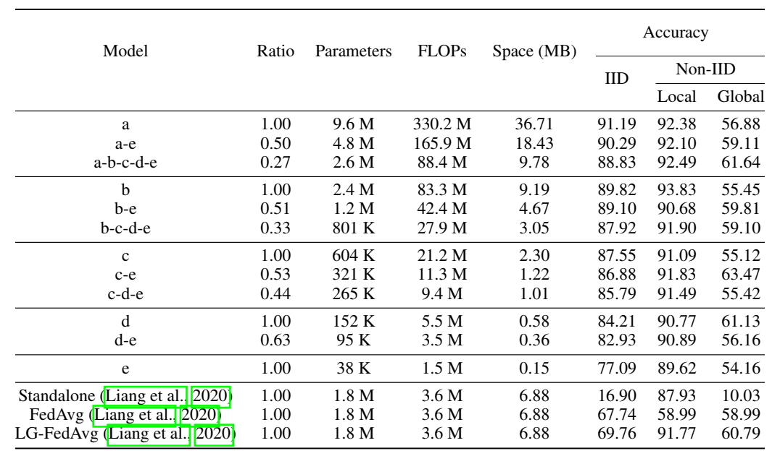
Experiments
Table 1. Results of combination of various computation complexity levels for CIFAR10 dataset.
Notes:
In this table, for `c-e’ half of the clients are trained with larger models `c’, while the other half are trained with the smaller models `e’. The takeaway is that a weak learner that can only train a small model `e' (on CIFAR10)(77.09\%) can boost its performance to `c-e' (86.88\%), `b-e' (89.10\%), or `a-e' (90.29\%), which are close to the scenario where all the learners are strong, namely c(87.55\ alone %), b(89.82\%), or a(91.99\%).

Slide 10
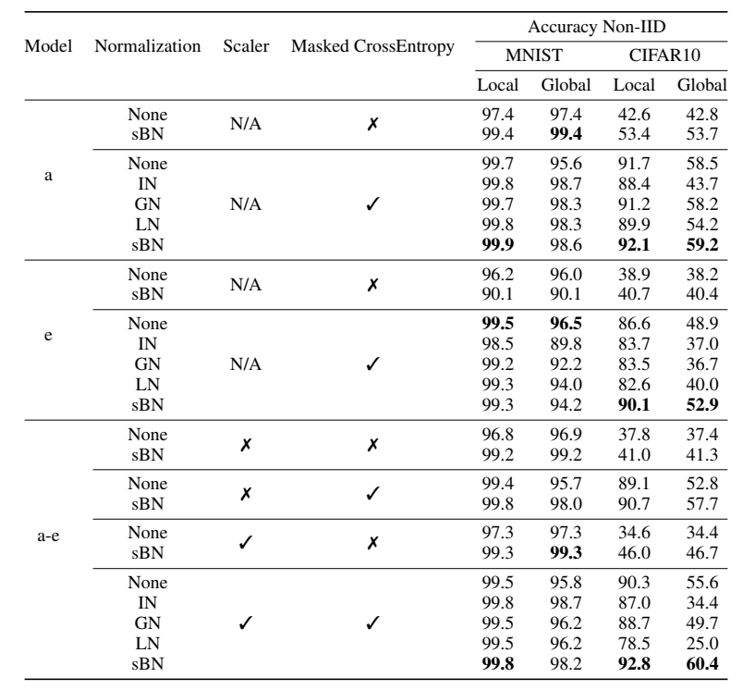
Experiments
Table 2. Ablation Study of Non-IID scenarios. Our methods significantly improve the local performance and moderately improves global performance.
.
Notes:
We also conduct ablation study and show the effectiveness our proposed techniques. In particular, Static Batch Normalization (sBN) outperforms alternatives like Instance Normalization, Group Normalization and Layer Normalization. sBN also shows faster convergence and save communication costs. Scaler stables the training of HeteroFL and produces better results, especially when sBN is not used. Masked Cross-Entropy Loss significantly improve the local performance of Non-IID data setting.

Slide 11
Conclusion
We identify the possibility of model heterogeneity and propose an easy-to-implement framework HeteroFL that can train heterogeneous local models.
Our proposed solution addresses various heterogeneous settings where different proportions of clients have distinct computation and communication capabilities.
We introduce several strategies including static Batch Normalization (sBN), scaler, and Masked Cross-Entropy Loss for significantly improving HeteroFL against the non-IID statistical heterogeneity.
Notes:
We identify the possibility of model heterogeneity and propose an easy-to-implement framework HeteroFL that can train heterogeneous local models.
Our proposed solution addresses various heterogeneous settings where different proportions of clients have distinct computation and communication capabilities.
We introduce several strategies and significantly improving HeteroFL against the non-IID statistical heterogeneity.

Slide 12
Thank you!

